Slide 1


SAP UI5 & FIORI with OData TRAINING
Anubhav Oberoy & Nishan Nainsukha
Day – 12

Slide 2

Agenda – Day 12
Fragments
Fragment loading
Types of Fragments
Working with Messages
Fragments as Dialog
Types of Dialog Fragment
Responsive behavior of Dialog
Dropdowns in SAPUI5

Slide 3
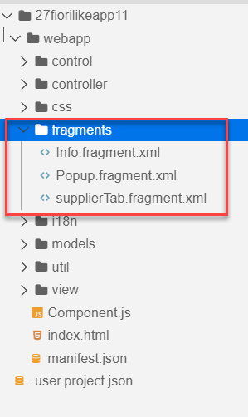
What is fragment ?
Fragments are light-weight UI parts. They are used to modularize views. We can reuse a fragment multiple times in same view or other views.
This class acts as factory which returns the UI control tree defined inside the Fragments.
Fragments are used similar as sap.ui.core.mvc.Views, but Fragments do not have their own controllers. Logic related to fragment’s UI elements is written in the host view’s controller.
Fragments are used similar as sap. ui.
Do not call the Fragment constructor directly!
Use-cases for Fragments are e.g.: - Modularization of UIs without fragmenting the controller structure - Re-use of UI parts - 100%- declarative definition of Views.
Constructor of Fragment is new sap.ui.core.Fragment()
View
View
Popup
Fragment
Popup
View
View
Popup

Slide 4
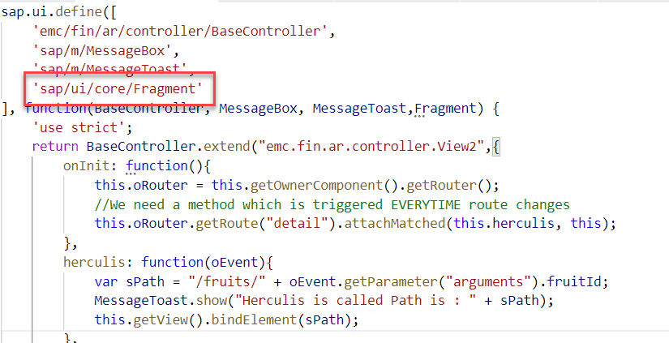
Fragment loading
Loads and instantiates a Fragment. A Promise is returned, which resolves with the Fragments content.
The Fragment types "XML", "JS" and "HTML" are available by default; additional Fragment types can be added using the sap.ui.core.Fragment.registerType() function.
Fragments can be instantiated from JSViews, as well. Fragments of any type can be used within views of any type.
Module name for fragment loading is “sap/ui/core/Fragment”

Slide 5
Tables in SAPUI5 and Fiori
sap.m.Table
The sap.m.Table control provides a set of sophisticated and convenience functions for responsive table design.
To render the sap.m.Table control properly, the order of the columns aggregation should match with the order of the cells aggregation (sap.m.ColumnListItem).
Reference: https://sapui5.hana.ondemand.com/#/api/sap.m.Table
sap.ui.Table
Provides a comprehensive set of features for displaying and dealing with vast amounts of data.
The Table control supports desktop PCs and tablet devices.
Reference: https://sapui5.hana.ondemand.com/#/api/sap.ui.table.Table

Slide 6

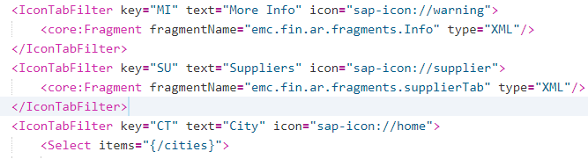
Exercise 1
Create a XML fragment
1.1 Info.fragment.xml
1.2 supplierTab.fragment.xml
2. View2.view.xml

Slide 7
What is Message
Messages can be used to notify the user about specific states of the application and can help the user to correct their incorrect inputs.
SAPUI5 provides a central place for storing and managing info, warning, and error Messages.
Message Object Properties
Target: Describes the part of the application to which the message applies.
Message processor: The object that handles the message in the application and propagates the message to correct controls , binding, or other object.
Types: Defines the severity of the message; possible types are error, warning, info, success.
Message Text: The actual message text describing the issue.
Persistent: This property influences the lifecycle of the message.

Slide 8
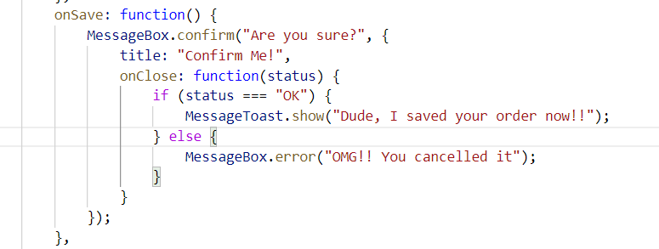
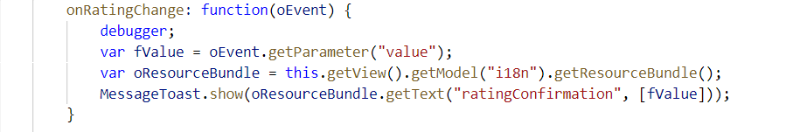
Message Dialog
A message dialog interrupts the user's workflow by blocking the current page and needs to be closed by the user.
Use a message dialog if the message is important and must be acknowledged by the user.
The easiest way of showing message dialog is to use the sap.m.MessageBox.

Slide 9
Types of MessageDialog
MessageStrip is a control that enables the embedding of application-related messages in the application.
A message toast is a small, non-disruptive popup for success or information messages that disappears automatically after a few seconds.
Method: sap.m.MessageToast.show()
MessageBox provides several functions:
show(), alert(), confirm(), error(), information(), success(), warning
MessageBox
MessageToast
MessageStrip

Slide 10
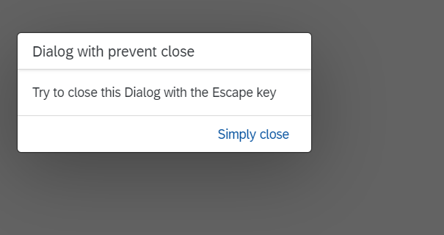
Fragment as Dialog
The Dialog control is used to prompt the user for an action or a confirmation.
It interrupts the current app processing as it is the only focused UI element and the main screen is dimmed/blocked.
The content of the Dialog is fully customizable.
API Reference: https://sapui5.hana.ondemand.com/sdk/#/api/sap.m.Dialog%23overview
Structure of Dialog:
A Dialog consists of a title, optional subtitle, content area and a footer for action buttons.
The Dialog is usually displayed at the center of the screen.
Its size and position can be changed by the user. To enable this, You need to set the properties resizable and draggable accordingly.

Slide 11
Responsive behavior of Dialog
Uses:
To display a system message.
To interrupt the user’s action.
To show a message with a short and a long description.
Behavior:
If the stretch property is set to true, the Dialog displays on full screen
If the contentWIdth and/or contentHeight properties are set, the Dialog will try to fill those sizes.
If there is no specific sizing, the Dialog will try to adjust its size t its content.
Smartphones
If the Dialog has one or two actions, they will cover the entire footer. If there are more actions, they will overflow.
Tablets
The action buttons in the toolbar are right-aligned. Use cozy mode on tablet devices.
Desktop
The action buttons in the toolbar are right-aligned. Use compact mode on desktop.

Slide 12

Exercise 2
Add a Dialog box
Add a Select Dialog fragment
1.1 add a filter in supplier data
1.1.1 Popup.fragment.xml
2. Add a filter button in SupplierTab.fragment.xml
3. Add a filter functionality in view2.controller.js

Slide 13
Dropdowns in SAPUI5
There are different types of dropdowns in SAP UI5
These are used to select single or multiple values
A drop-down list for selecting and filtering values.
select only one item in a long list of options
ComboBox
Dropdowns
The user needs to select one or more options from a long list of options
The sap.m.Select control provides a list of items that allows users to select an item.
Select
Multi Combo Box

Slide 14

Exercise 3
Add dropdowns in City Section
1. View2.view.xml
Add dropdowns in City Section
1. View2.view.xml
Exercise 4
Add Input Field (F4 HELP) in Table
View2.view.xml
View2.controller.js
Supplier.fragment.xml
ValueHelpDialog.fragment.xml

Slide 15

End of Day 12

Slide 16
Title
Content

Slide 17

Any Questions ?

Slide 18

Anubhav Oberoy

